Slide 1
Energy Efficiency in Buildings
Scale up implementation
EEB 2.0 Update
April 2013

Slide 2

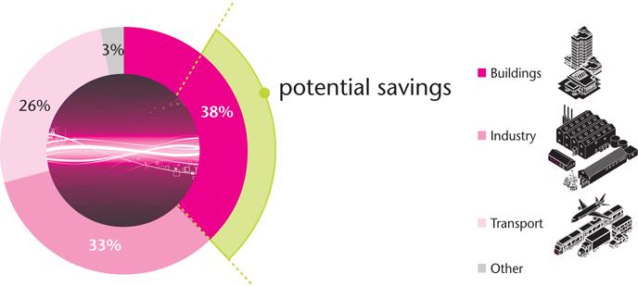



Why EEB? Buildings are Largest Consumers
Buildings are the “invisible” large consumers of energy and emitters of CO2
Source: IEA “Worldwide Trends in Energy Use and Efficiency”, (2008)
Notes:
According to the International Energy Agency, buildings are the largest consumers of energy in the world, representing 38% of all energy use.
Energy consumption of buildings is often overlooked, or underestimated because it is more ‘invisible’, when compared to other more obvious energy-intensive sectors, such as transport or industry.
Without intervention, this figure is expected to grow, especially in countries where construction activities are booming, such as China and India
Many organizations, both public and private, are working on sustainability, and energy management in particular. EEB aims to complement these initiatives by providing a business perspective and developing practical action for property developers, energy providers, and suppliers of products and services to the building industry

Slide 3
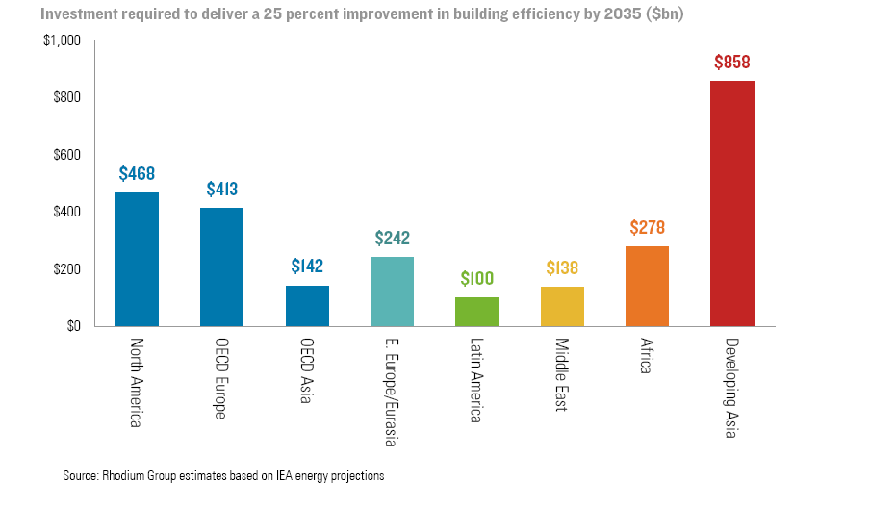
Why EEB? A Large Business Opportunity
Existing (~$1T )
Developing (~$1.6T)
Notes:
In addition to the obvious environmental benefits for reducing CO2 emissions, the research undertaken prior to the launch of EEB suggests that achieving a 25% improvement in building efficiency would also create a massive expansion of the energy efficiency market, equating to greatly increased investment opportunities , particularly in developing countries.
There is an increasing demand for energy efficient solutions for the transport, industrial and construction sectors. Those who are first to devise attractive business propositions will be most likely to gain the advantage .

Slide 4
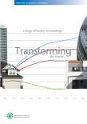
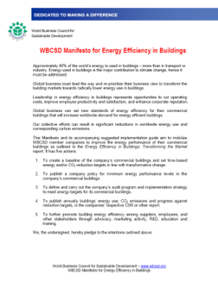
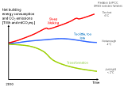
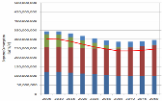
The First EEB Project
A world where buildings consume zero net energy
“Transforming the Market” report
EEB Manifesto: 118 Signatories to date
“Facts & Trends” report
Model Qualitative & Quantitative analysis
Workshops, Forums, Conferences
Project launch
2006 | 2007 | 2008 | 2009 | 2010
Notes:
The project’s first achievement was the publication of the Facts & Trends summary report, which combines the findings from existing research and stakeholder dialogues during hearings, workshops, and forums with a breakthrough market research study that measures the stakeholder perceptions of sustainable buildings around the world. The report establishes a baseline of current facts and trends. These have underpinned the scenario planning and modeling approaches used to assess the necessary actions to tackle energy consumption of buildings.
The project’s second milestone was the publication of its second report, Energy Efficiency in Buildings: Transforming the Market, launched in 2009. The report is based on a unique simulation model that analyzes the energy use of thousands of building types and millions of existing and new buildings, both commercial and residential. This model shows how energy use in buildings can be cut by 60% by 2050, which is essential to meeting global climate change targets.
The WBCSD then decided to bring a Manifesto for Energy Efficiency in Buildings to all members, calling on them to take voluntary action. By signing the Manifesto, companies “walk the talk” and send a strong message to the market, stakeholders & employees. To date the Manifesto has attracted 118 signatures and a growing number of case studies that demonstrate how companies are implementing the Manifesto
These key steps provided a basis for EEB 2.0, which is a more action-orientated phase started in January 2013

Slide 5
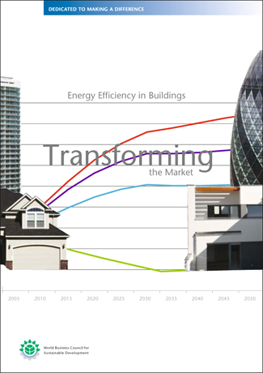
“Transforming the Market” stated:
“…At energy prices proportional to US$ 60 per barrel,
building energy efficiency measures totaling $ 150bn annually*
will reduce related energy use
by 40% with a discounted payback period of 5 years.
An additional 150bn US$ investment will reduce energy use by further 12% with payback periods of 5-10 years…”
* in 6 markets studied (Brazil, China, Europe, India, Japan, and the US)
… but change is not happening…
Notes:
The Transforming the Market report stated that, globally,

Slide 6
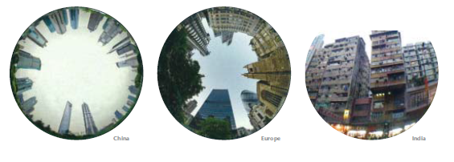
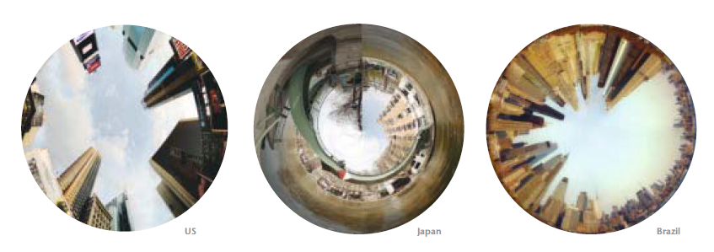
Why a new EEB project (EEB 2.0)?
EEB 2.0’s Ambition is simple but bold:
To Trigger Motivation for Change!

Slide 7

EEB 2.0: Objective
To Unlock financially viable energy efficiency investments that today are not being realized mostly because of non-technical (i.e. financial, regulatory, organizational) barriers .
How? By analyzing the decision-making process for energy efficiency measures we can identify the key barriers and develop recommendations how to overcome them.
Deliverable: We expect to develop a process that is replicable and scalable across different building portfolios.

Slide 8


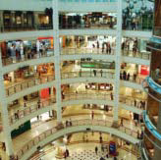
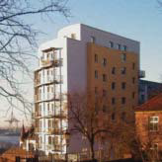
EEB 2 Decision Makers
A Decision Maker (DM) owns or manages a building portfolio*:
* Examples are for illustration only, no selection has been made, no one has been approached
 | Owner / Investor | Tenant
Housing Single family Multi family | Public sector (e.g. French Office HLM) Private sector (e.g. AXA)
Office | Institutional investor (e.g. CALPERS, Pension Denmark) Private sector portfolio /real estate developer (e.g. Prudential, La Française) Corporation (e.g. Siemens) Public sector portfolio (e.g. City of Paris, US GSA) | Global occupier (e.g. Deutsche Bank)
Hotels | Corporation (e.g. Marriott) Franchisor (e.g. Hilton)
Retail | Investor (e.g. Sonae Sierra) Corporation (e.g. WalMart) Franchisor (e.g. 7 Eleven) | Franchisee (e.g. H&M) Individual stores
Education | Public sector (e.g. Univ. South Carolina, Paris schools) Private sector (e.g. Oxford Univ., Infosys)
Warehouse | Corporation (e.g. Fedex, TNT)

Slide 9
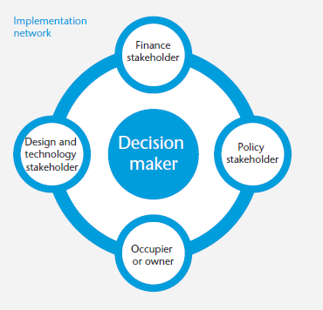
EEB 2 will work with Decision Makers
DM and their Implementation Network
A DM works with a wide and diverse group of players that may include agents, owners, building users, designers and financiers.
Stakeholders in his network have influence on or are impacted by DM decisions on energy efficiency measures
Decisions bring also collateral benefits
Collateral benefits
By analyzing the decision-making process for energy efficiency measures we can identify the key barriers and develop recommendations how to overcome them.
Collateral benefits
Notes:
The EEB 2.0 project, under the flagship of the WBCSD, will bring together the DMs, along with members of their network, which may include stakeholders from the policy or finance or technology or design arenas. Within these networks, identifying the value metrics for each player is essential to ensuring successful engagement.
The foundational work undertaken earlier on in the life of EEB identified that the collateral benefits that arise from these engagements are one of the unique selling points of this project e.g. the social, health, strategic and business benefits that ‘spin-off’ from the engagements.

Slide 10
Decision Makers Engagements
The Engagement Process & Key Outcome
Confirm stakeholder network and form expert group
Initial contact and assessment of issues at stake
Analysis & Scenario modeling
Decision Maker
Dialogue with DM and network
DM commits to ambitious EE plan
Implementation Plan
Engage authorities (local/ national to secure policy commitments
Key Outcome
DM commits to launching and implementing a project within the EEB framework,
with the aim of developing energy-efficient solutions
through partnership with all stakeholders involved
Notes:
This is probably the most time consuming and structurally difficult aspect of the process. Here, all efforts come together and experts will be required to legitimize the series of technical and non-technical recommendations for expected implementation. The analysis may need to be supported by analytical (modelled) analysis, expert testimony, business affirmation, and governmental commitments in order to affirm or validate the expected value metrics against each participant in the DM and IN.
As mentioned prior, EEB2.0 will need to create an Experts Network that can be used to develop, support, and ultimately commit to the approaches put forward in the Implementation Plan. These resources will be supported by Core Group company experts and resources that assist and qualify business legitimacy. Finally, when necessary, governmental commitments will need to be secured in order to support the implementation programs targeted that may require policy adjustments or approaches that support the plans application; and, ultimately a commitment to act by the DM.
The objective is to convince the DM and the relevant part of the IN to commit to launch an EE project with an ambition of EEB2 level that will achieve the desired value metrics identified in the “system” of stakeholders

Slide 11
How to scale up?
By documenting financially viable, replicable and scalable solutions in the decision-making process
… for the different market segments DMs represent
… disseminating these solutions through the EEB members and partner organizations
Ambition:
Secure commitments
from a wide range of market actors

Slide 12











EEB 2.0 Members and Partners
Co-chairs
Members
Membership remains open for up to 9 more companies
Partners
World Green
Building Council

Slide 13
Project governance
  3-Year Project (2013-15) driven by annual plan and objectives
  Core Group between 10 and 15
  2-3 co-chairs (Lafarge and UTC, to date)
  Core Group Sr. Exec oversee project at Co-Chair invitation
  Assurance Group guides project quality
  Agreed project fees to cover project costs
  All members commit in-kind resources
  Company experts to be reimbursed, pro-rata, allowance for external consultants
  Partners leverage skills and networks
  Governance document formalizes guidelines and decision making rules and structure for key partnerships
Notes:
A well-managed project requires a strong governance structure. The model for EEB 2.0 will follow that established in the earlier stages of the project. A final governance document will be developed that articulates the roles and responsibilities and the decision-making process within the group. It will also clarify and formalize the relationships between the EEB Core group and partner organizations such as ULI, and WGBC. The benefit of working with partner organizations is the ability to leverage skills and to access networks of strategic relevance to EEB.
The EEB 2.0 Core group will be composed of representatives from 10-15 companies with an interest in supporting a project aimed at energy efficiency. The Core Group will be led by two co-chairs from the companies United Technologies Corporation (UTC) and Lafarge. The Assurance Group will provide expert advice and guidance to the Core Group. Support from the CEOs of the Core Group companies will help to direct the project as it develops.
EEB 2.0 is financed through a fee-system whereby funds are derived from participating member companies. Under this structure, core-group members pay $36,000 for the year 2013-2014 and the Co-chairs pay twice this sum. In addition to this, member companies contribute in-kind resources, primarily in the form of staff time.
When company experts are engaged, they will be reimbursed pro rata. This fee structure will commence in 2013 and will continue on a year-over-year basis. In planning this finance structure, it was decided that if fewer than 16 members are recruited to the project, the fee will not chance, but fewer engagement processes (i.e. <10) will be undertaken

Slide 14

EEB 2 Timeline: 2012-2016+
Internal Survey
Learning engagements
Case Study Reports
DM Selection
DM 1
DM 8-10
Project Kick-off (Jan ‘13)
Gain DM Commitments
SE Review
SE Review
SE Review
Phase 0
2012
2013
2014
2015
2016
Assurance Group
Assurance Group
Assurance Group
Qualification of Engagement Process
Notes:
2013 will commence with a learning phase, the objective of which will be to fully understand the needs of Decision Makers so that we can plan the subsequent engagements in a more informed way. Elements of this first year will include a thorough literature review as well as an ‘Alpha Phase’ whereby companies contribute internal knowledge and experience to the project. A consultant will be engaged to design a survey that will capture this information.
On the basis of the learnings derived from these steps, the second half of 2013 the project will move towards building the value proposition of EEB 2.0. The first engagement process is scheduled for June 2013 (the ‘Beta engagement’) and will target a public buildings owner.
Following on from this, EEB 2.0 will seek to achieve one DM engagement per quarter. Moving into 2014, EEB 2.0 will focus on project advocacy, highlighting and communicating its objectives and achievements. The Assurance Group is scheduled to meet once a year, every year, with Senior Executive Review occurring at similar intervals.

Slide 15
Project Work Plan
1st Half 2013
June 2013 to Dec 2015
From 1st Half 2014
Phase 1
Understand
DMs’ Needs
Phase 2
Build and Test
Value Proposition
Phase 3
Deploy
Get commitments
Internal Survey :
with EEB 2 company experts to understand key barriers
Learning engagements:
San Francisco (ULI)
Infosys, India
Decision Maker selection
“Beta” Test (June-Aug)
1 DM engagement per quarter
“Deep dives”/case studies
Dos and Don’ts
Replicability
Meeting to share findings of survey
Promote EEB 2 process, leveraging Partner Organizations and the BCSDs

Slide 16
Why should you join EEB 2.0?
Leverage Project Investments
  Leverage against a company’s level of planned investment
  Positioning for actual building projects with committed owners/ investors
Business Relationships and Network
  Develop valuable insights and relationships from Decision-Maker and Implementation Network engagements
    Impact on future product and service offerings
Learn from Others
  Diverse environment of learning for EEB outside of a company’s core area of expertise
Brand Leadership Visibility and Position
  Valuable visibility in global and local markets
  Increased brand or corporate identity with EEB 2.0

Slide 17

Philippe Fonta
WBCSD Managing Director
fonta@wbcsd.org
+41 22 839 31 04
Roland Hunziker
EEB Project Director
hunziker@wbcsd.org
+41 22 839 31 84

