Slide 1

Energy Efficiency and Renewables role in the future energy needs
Vladimir Kubecek, IEA
4 June 2018
IEA

Slide 2
Outline
World Energy Outlook
Energy Efficiency Indicators Highlights
Energy Efficiency/Energy Analysis
  Energy Efficiency Manuals
  World Energy Outlook
  Energy Technology Perspectives
  Market Report Series
  Other Reports

Slide 3
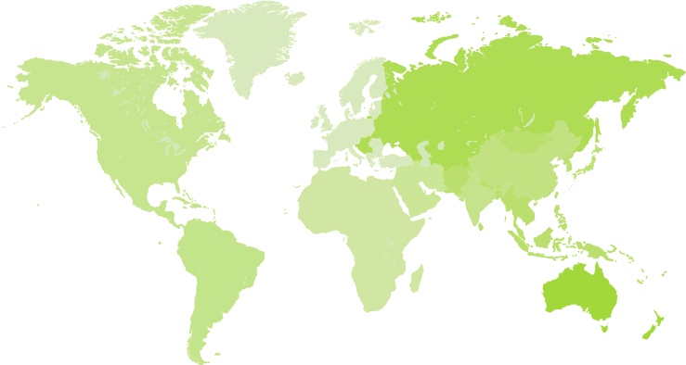
India takes the lead, as China energy growth slows
Change in energy demand, 2016-40 (Mtoe)
Europe
-200
135
Eurasia
United States
-30
480
China 790
Japan
-50
Middle
East
485
India
1 005
Southeast
Asia
420
Central and
South America
270
Africa
Old ways of understanding the world of energy are losing value as countries change roles:
the Middle East is fast becoming a major energy consumer & the United States a major exporter

Slide 4
Average annual change in final energy consumption in the New Policies Scenario, 2016-2040
Energy efficiency halts demand growth in advanced economies
Notes:
IEA analysis based on decomposition analysis. This statistical approach identifies the relative influence on energy demand of changes in efficiency, fuel switching, economic structure and activity.

Slide 5
Renewable energy use by sector from a consumer perspective and by region in the NPS
Renewables-based electricity leads the expansion in renewable energy use in the New Policies Scenario
Notes:
All sectors are considered from a consumer perspective, i.e. electricity shown represents the share of electricity demand provided by renewables, including electricity used for transport and heat.

Slide 6




A new strategy for energy & sustainable development
Global CO₂ emissions by scenario
Gt
40
New Policies Scenario
30
Sustainable Development Scenario
20
Sustainable Development Scenario
10
2000
2010
2020
2030
2040
The Sustainable Development Scenario reduces CO₂ emissions in line with the objectives of the Paris Agreement, while also tackling air pollution and achieving universal energy access

Slide 7
Global CO₂ emissions reductions in the New Policies and Sustainable Development Scenarios
Energy efficiency and renewables account for 80% of the cumulative CO₂ emissions savings in the Sustainable Development Scenario

Slide 8
Change in global industrial heat supply mix by temperature level by scenario, 2016-2040
New and renewable energy technologies address low-temperature needs and even exceed conventional energy sources in the Sustainable Development Scenario
Notes:
* Other fuels include conventional fossil fuels and direct heat supply.
NPS = New Policies Scenario; SDS = Sustainable Development Scenario.

Slide 9
Cumulative global energy investment by scenario, 2017-2040
Investment in the power sector is substantially larger than spending on oil and gas supply in the Sustainable Development Scenario
Notes:
NPS = New Policies Scenario; SDS = Sustainable Development Scenario; T&D = transmission and distribution.

Slide 10
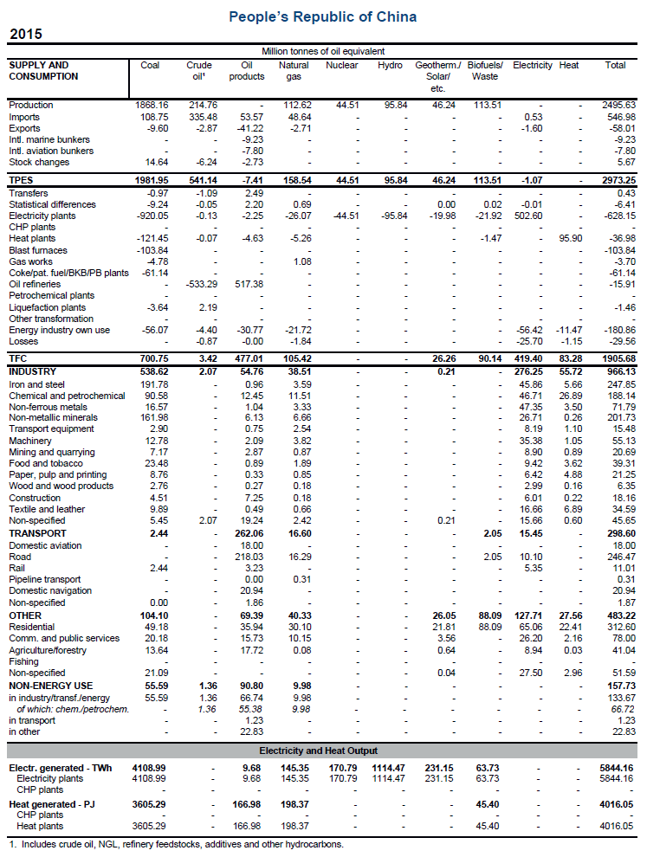
IEA energy balance layout: compact source of information
People’s Republic of China
Totals
Supply
Comparable information
for all products
Transformation and energy industries own use
Final consumption
Comparable energy
units (Mtoe)
Industry
Global picture of energy situation in a country
Transport
Other final consumption
Non-energy use
Electricity and heat output

Slide 11
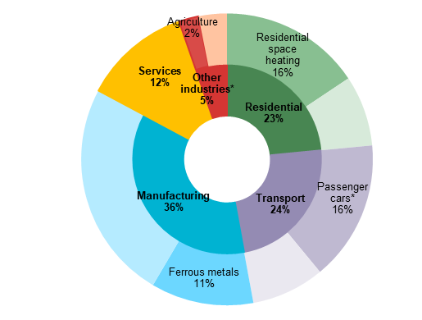
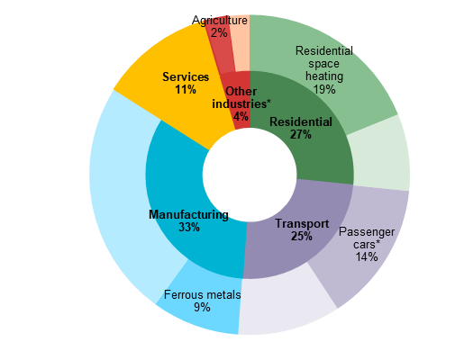
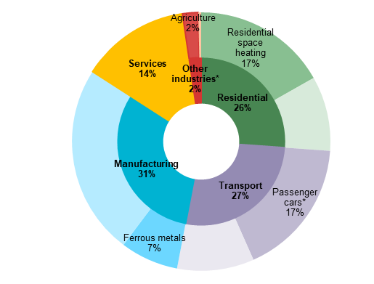
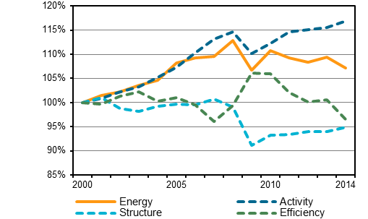
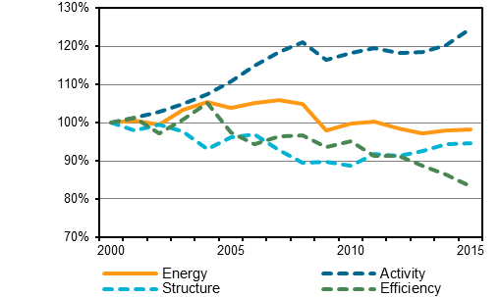
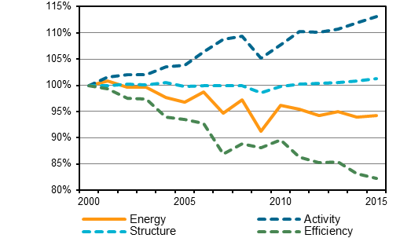
Energy Efficiency Indicators – End Use Sectors
Austria
Czech Republic
Germany
People’s Republic of China

Slide 12
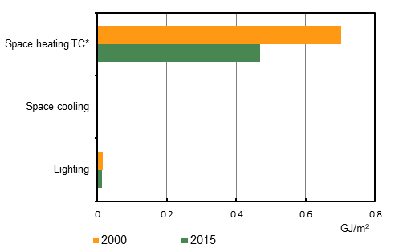
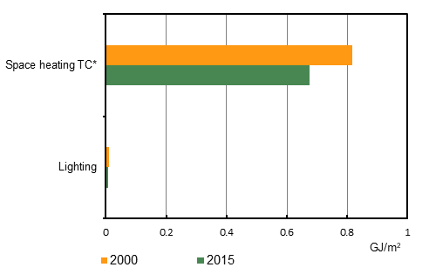
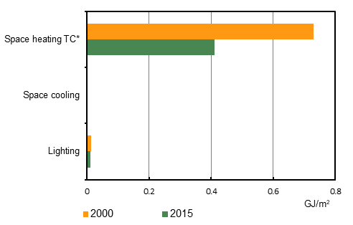
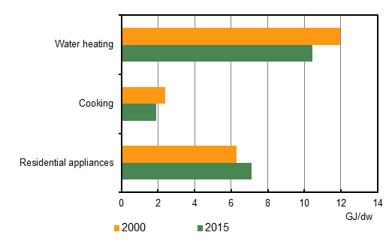
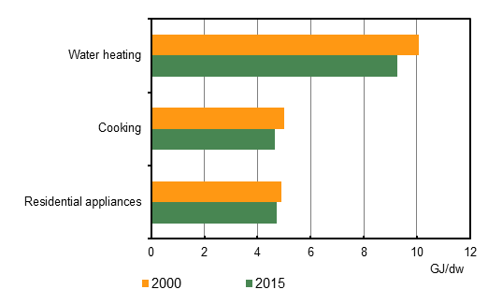
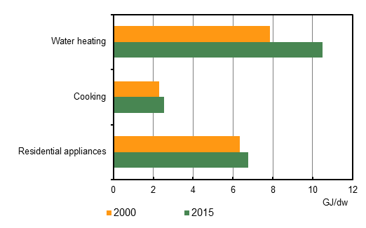
Energy Efficiency Indicators – Residential
Austria
Czech Republic
Germany
People’s Republic of China

Slide 13
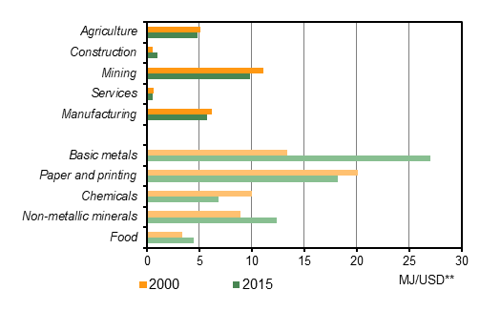
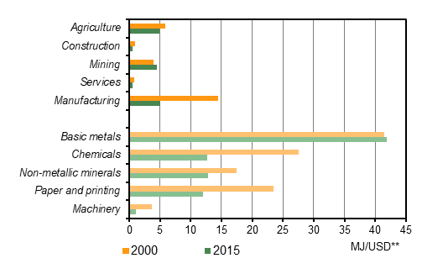
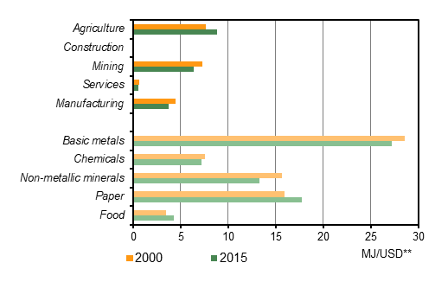
Energy Efficiency Indicators – Industry
Austria
Czech Republic
Germany
People’s Republic of China

Slide 14
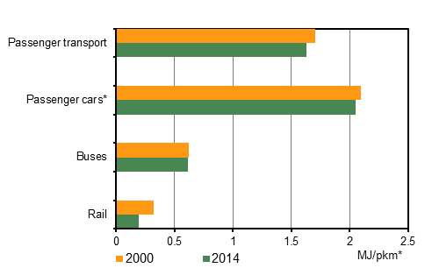
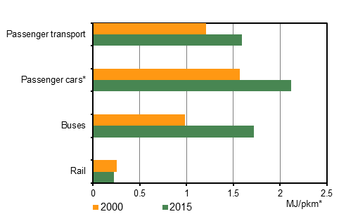
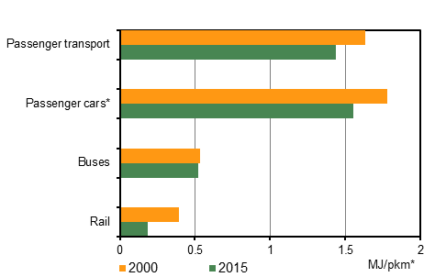
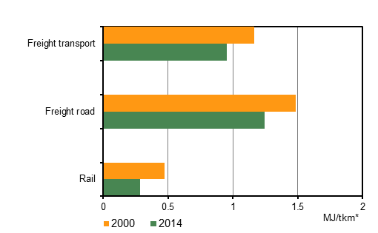
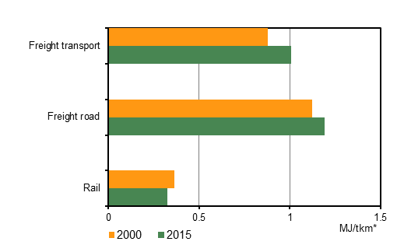
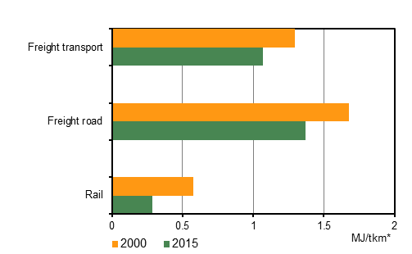
Energy Efficiency Indicators – Transport
Austria
Czech Republic
Germany
People’s Republic of China

Slide 15
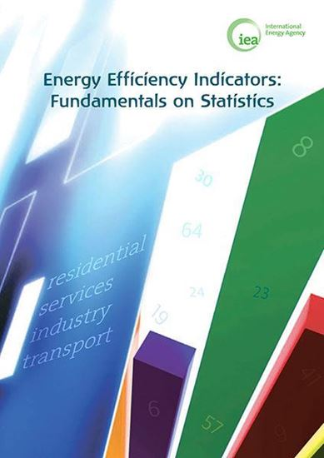
Energy Efficiency
Energy Efficiency Indicators: Fundamentals on Statistics
https://www.iea.org/eeindicatorsmanual/
Policies database https://www.iea.org/policiesandmeasures/
  Addressing Climate Change Database
  IEA/IRENA Global Renewable Energy Policies and Measures Database
  Energy Efficiency Database
  Building Energy Efficiency Policies (BEEP) Database

Slide 16
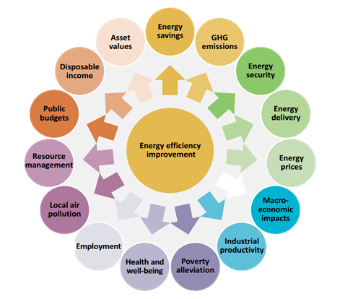
Conclusion
Energy Efficiency is not equivalent to energy savings
  There are multiple benefits to it and policies must take it into account
For right policies right data are essential not only for setting up but mainly for evaluation
Sharing/using experience can save a lot of side tracking

Slide 17
NEW IEA statistics website – due to be launched soon
www.iea.org/statistics

Slide 18

World Energy Outlook
Long term Scenarios up to 2040
Every year
  Focus on fuel
  Focus on Country/Region
  Special reports
https://www.iea.org/weo/

Slide 19

Energy Technology
Long term scenarios
Role of technologies in the Energy Transitions
http://www.iea.org/etp2017/summary/
Tracking Clean Technology
http://www.iea.org/tcep/

Slide 20
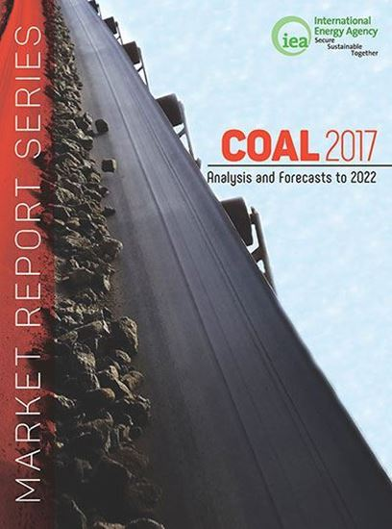
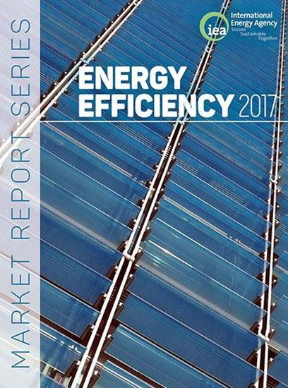
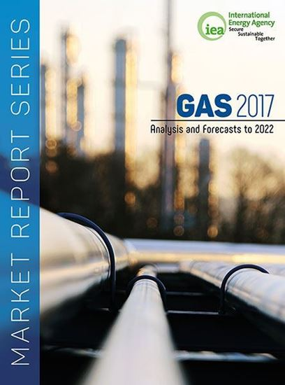
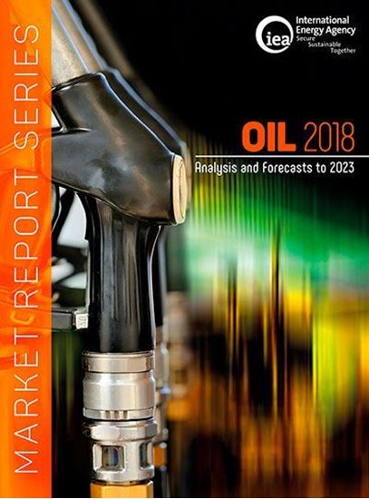
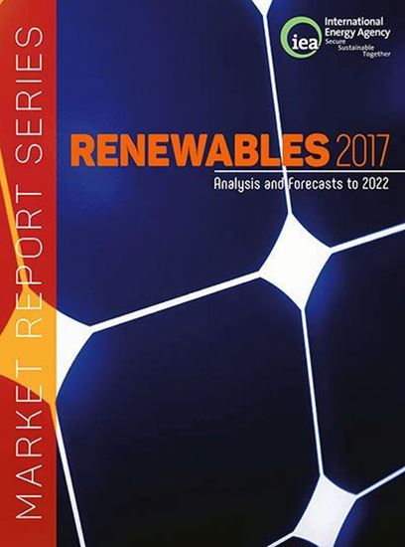
Market Report Series
Medium Term Projections
  Coal
  Energy Efficiency
  Gas
  Oil
  Renewables
5 years ahead
Focus on current trends in production,
trade and consumption
Covering key regions/countries

Slide 21



Other Reports
Digitalization and Energy
  http://www.iea.org/digital/
World Energy Investment
  http://www.iea.org/topics/investment/
Country Reports
  Energy Policies of IEA Countries
Oil Market Report
  Monthly Oil report
  https://www.iea.org/oilmarketreport/omrpublic/

